Slide 1

Image Stitching
Image Processing Project

Slide 2
Introduction
Panorama is a success in the field of computer vision.
Published by Matthew Brown and David G. Lowe in the Panoramic image stitching paper in 2007, since then it has been applied popularly in Google Street View or typically as photography applications in modern smartphones.

Slide 3
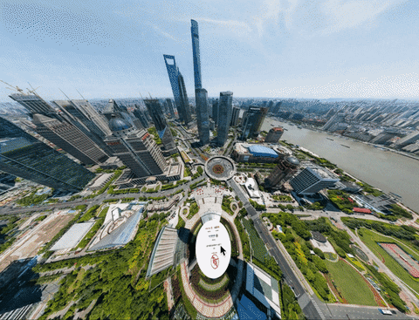
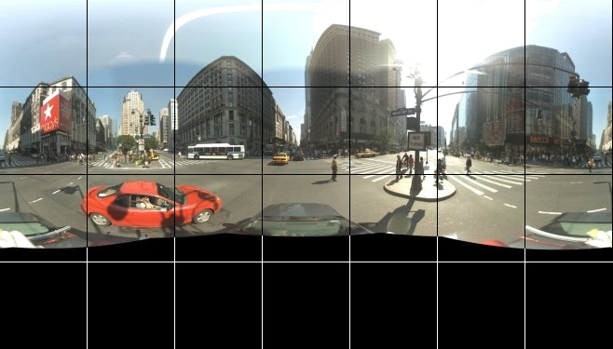
Image Stitching Algorithm
Today we will find out how a panoramic image is created by

Slide 4
Table of contents
01
02
03
04
Keypoints Detection
Keypoints Matching
Perspective Transform
Warping Transformation

Slide 5
01
Keypoints Detection

Slide 6

Harris Corner Algorithm
An initial and probably naive approach would be to extract key points using an algorithm such as Harris Corners, which was first introduced by Chris Harris and Mike Stephens in 1988.
As we know, corners have one nice property: they are invariant to rotation. It means that, once we detect a corner, if we rotate an image, that corner will still be there.

Slide 7
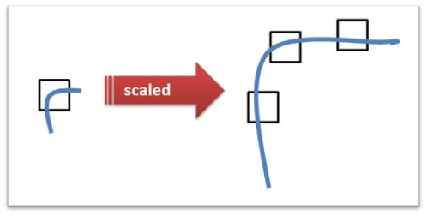
Harris Corner Algorithm
However, what if we rotate then scale an image? In this situation, we would have a hard time because corners are not invariant to scale.
That is to say, if we zoom-in to an image, the previously detected corner might become a line!

Slide 8
SIFT Algorithm
Scale Invariant Feature Transform
Detect Keypoint
These keypoints are special, feature-rich and distinctive.

Slide 9
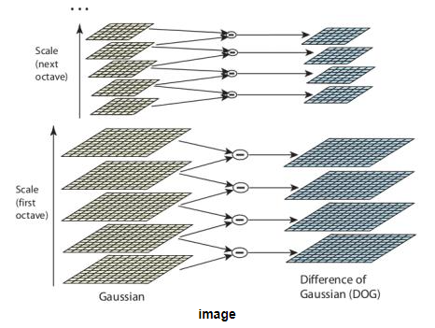
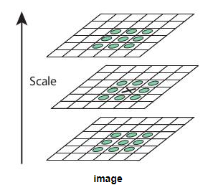
How to find a keypoint?
Once this DoG are found, images are searched for local extrema over scale and space

Slide 10

SIFT Algorithm
For each Keypoint, SIFT returns the coordinates (x, y) with Descriptor - a 128-dimensional vector representing the features of that keypoint.
v = [v₁, v₂, v₃ …, v₁₂₇, v₁₂₈]
These vector descriptors are not/less affected by rotation, light, scale...
That means that the same point appearing on 2 images (regardless of the angle of view, different brightness) will have approximately the same descriptor.

Slide 11

02
Keypoints Matching

Slide 12
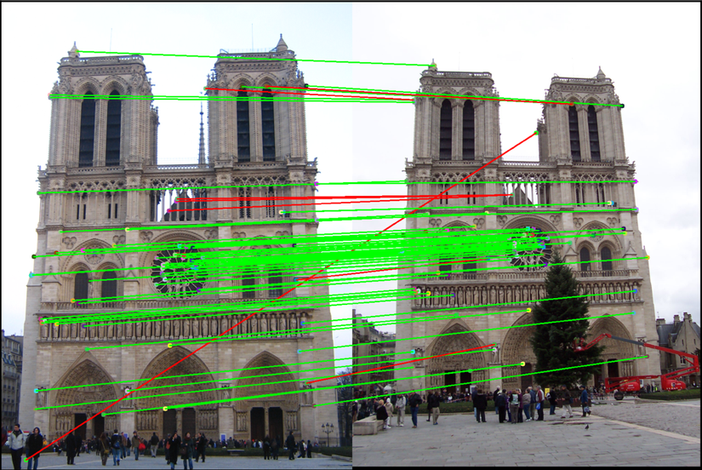
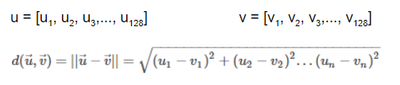
Keypoints Matching
Suppose we have extracted 2 keypoint sets on 2 images S₁ = {k₁, k₂, k₃,..., k_{n}} and S₂ = {k₁’, k₂’, k₃’,..., k_{n}’}
We need to match the keypoint in these 2 sets to find out the corresponding keypoint pairs on the 2 images.
People often use the Euclidean distance between 2 Descriptors of 2 keypoints to measure the difference between these 2 keypoints.

Slide 13
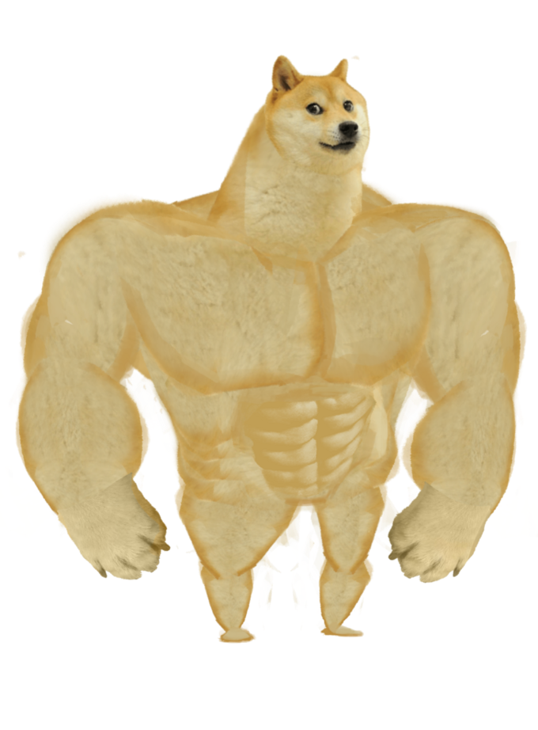
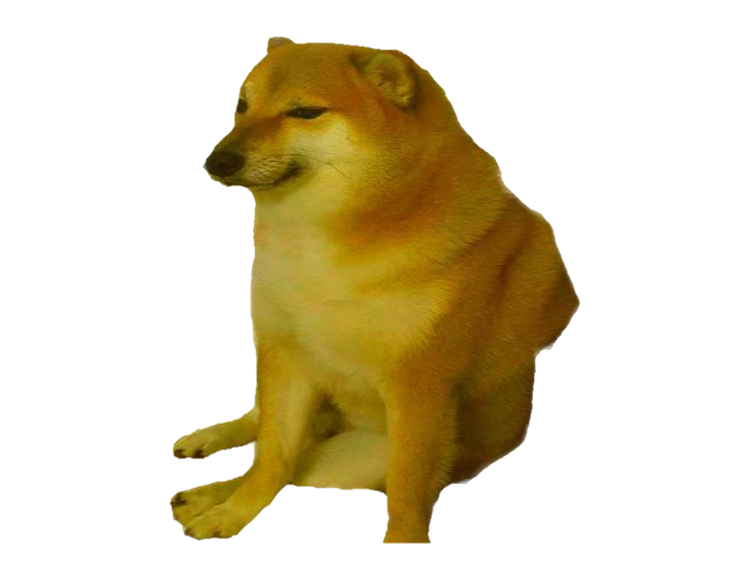
To match 2 sets of keypoint together
Brute Force Matching
FLANN Matching
A rough calculation
Have to calculate the Euclidean distance between 1 keypoint k in S1 and all the points in S2
=> Thereby finding the best match points between the 2 sets.
"Fast Library for Approximate Nearest Neighbors"
Faster than BF matching
Less computation
“Sometimes we just need good enough scores but we don't need to find the best score.”

Slide 14

03
Perspective Transform
estimate homography matrix

Slide 15
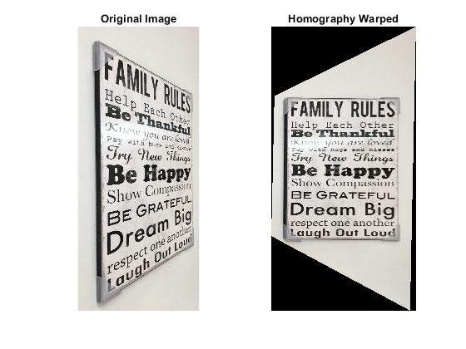
Homography Matrix
Now, we need to take these points and find the transformation matrix that will stitch these images together based on their matching points.
Such a transformation is called the Homography matrix. Briefly, the homography is a 3x3 matrix that can be used in many applications such as camera pose estimation, perspective correction, and image stitching.
Homography is a 2D transformation. It maps points from one plane (image) to another.

Slide 16

Estimating the Homography
To calculate a homography between two images, we need to know at least 4 point correspondences between the two images. If we have more than 4 corresponding points, it is even better.
OpenCV provides the cv2.findHomography() function which will robustly estimate a homography that best fits all corresponding points.
Usually, these point correspondences are found automatically by matching features like SIFT or SURF between the images.

Slide 17
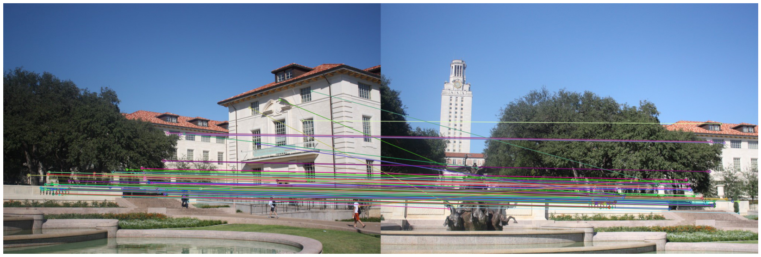
RANSAC
However, It turns out that the Homography is very sensitive to the quality of data we pass to it. Hence, it is important to have an algorithm that can filter points that clearly belong to the data distribution from the ones which do not.
In our project, we use RANdom SAmple Consensus or RANSAC which is an iterative algorithm to fit linear models.
Different from other linear regressors, RANSAC is designed to be robust to outliers.

Slide 18
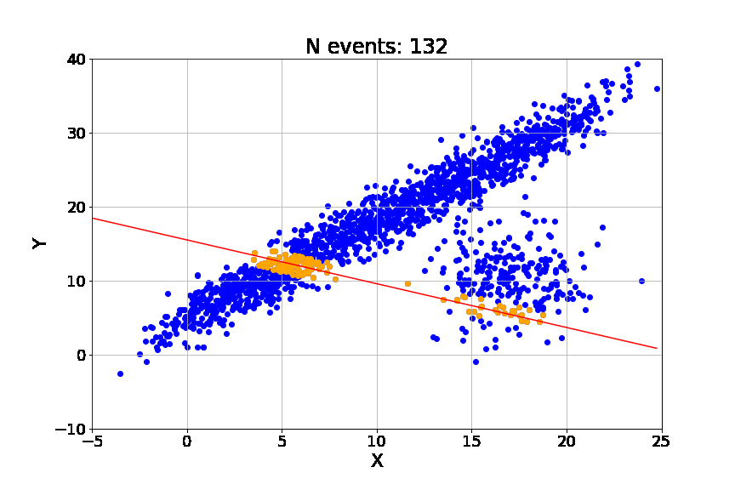
Linear Regression
We can see that the Linear Regression model gets easily influenced by the outliers.
That is because it is trying to reduce the average error.
Thus, it tends to favor models that minimize the overall distance from all data points to the model itself. And that includes outliers.

Slide 19
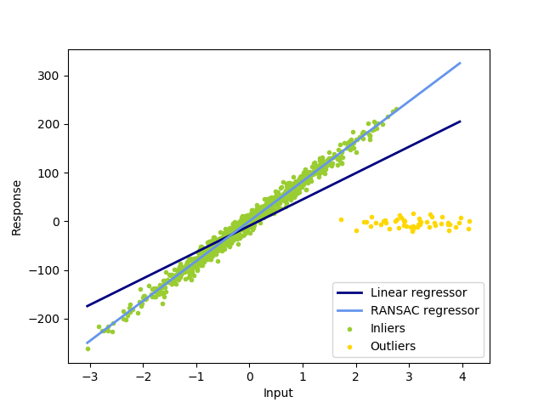
RANSAC
On the contrary, RANSAC only fits the model on the subset of points identified as the inliers.

Slide 20

04
Warping Transformation

Slide 21

Warping Transformation
Once we have the estimated Homography, we need to warp one of the images to a common plane.
Here, we are going to apply a perspective transformation to one of the images. Basically, a perspective transform may combine one or more operations like rotation, scale, translation, or shear.

Slide 22
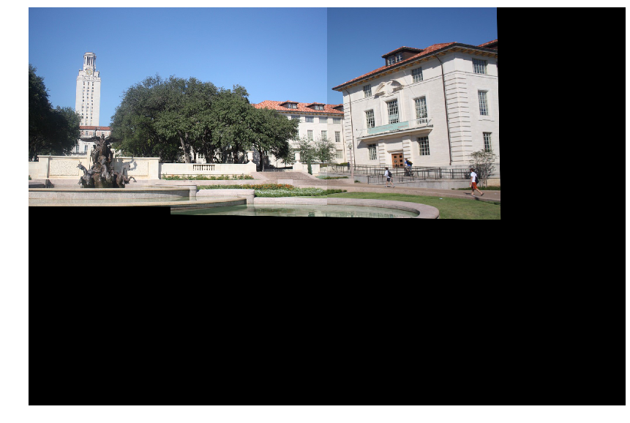
Warping Transformation
The idea is to transform one of the images so that both images merge as one.
To do this, we can use the OpenCV warpPerspective() function.
It takes an image and the homography as input. Then, it warps the source image to the destination based on the homography.

Slide 23
Thanks for listening!

